Slide 1
Data provenance → reproducible, transparent, and well-documented code for statistical analysis and modelling in R
BES 2019 Pre-conference Workshop

Slide 2
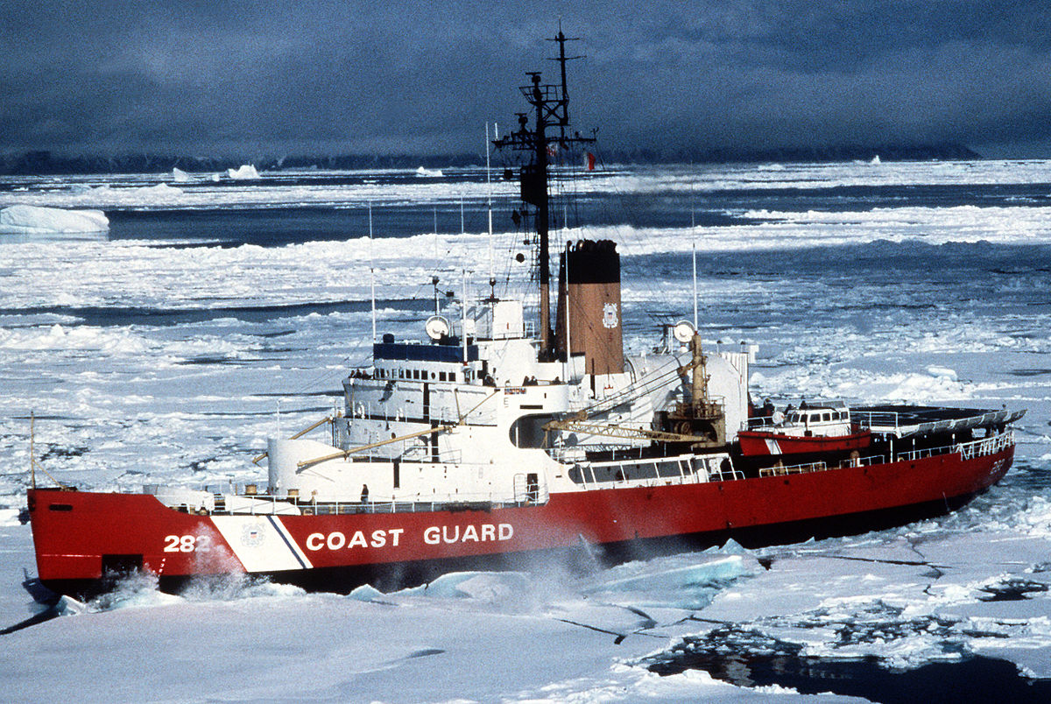
Ice-breakers
Pair up with someone you don't know. Each person take one minute to describe their professional selves to the other person
Pair up with someone else you don't know. Each person take one minute to describe their non-professional selves to the other person
Pair up with someone you don't know. Take one minute to describe your professional self to the other person. Switch.
Pair up with someone else you don't know. Take one minute to describe your non-professional self to the other person. Switch.

Slide 3
Warm-up questions
Why are trustworthy data and code important?
What defines trustworthy data and code?
Can you recognize trustworthy data or code?
What experiences have you had with trustworthy or untrustworthy data or code→...

Slide 4
Have you:
Used data collected by someone else?
How did you obtain it?
Was it immediately understandable and usable?
If not, why not?
Used code written by someone else?
For what purpose?
How did you obtain it?
Did it run on your first try?
When did you give up in frustration?

Slide 5
Have you:
Posted data to a repository? (if not, why not?)
Which one?
How did you document it?
Has anyone else used it?
Did they ask you any questions about it?
Posted custom code to a repository? (if not, why not?)
Which one?
What does it do?
Has anyone else used it?
Did you get any feedback about it?

Slide 6

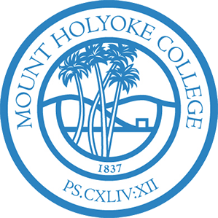




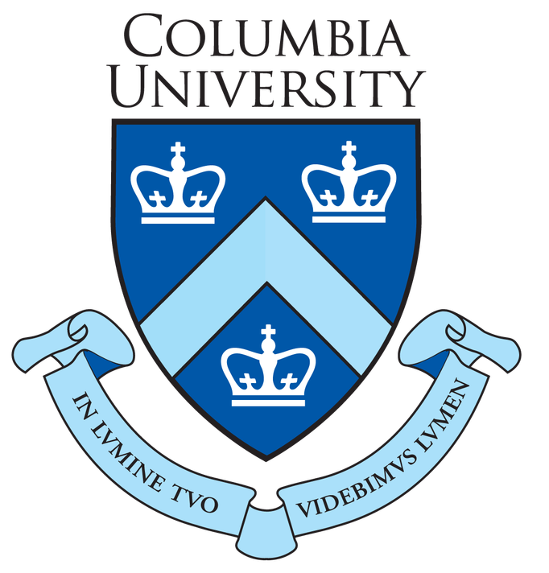


Data provenance → reproducible, transparent, and well-documented code for statistical analysis and modelling in R
Aaron M. Ellison
Emery Boose, Orenna Brand, Elizabeth Fong, Matthew K. Lau, Barbara S. Lerner, Khanh Ngo, Thomas Pasquier, Sydne Record, Joseph Wonsil, and Margo I. Seltzer

Slide 7
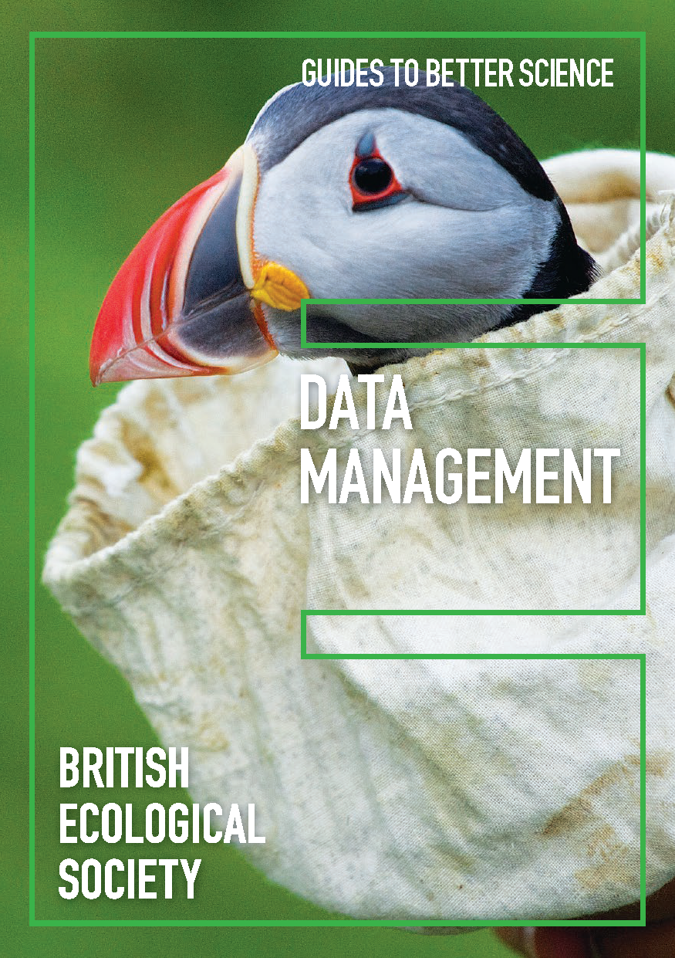
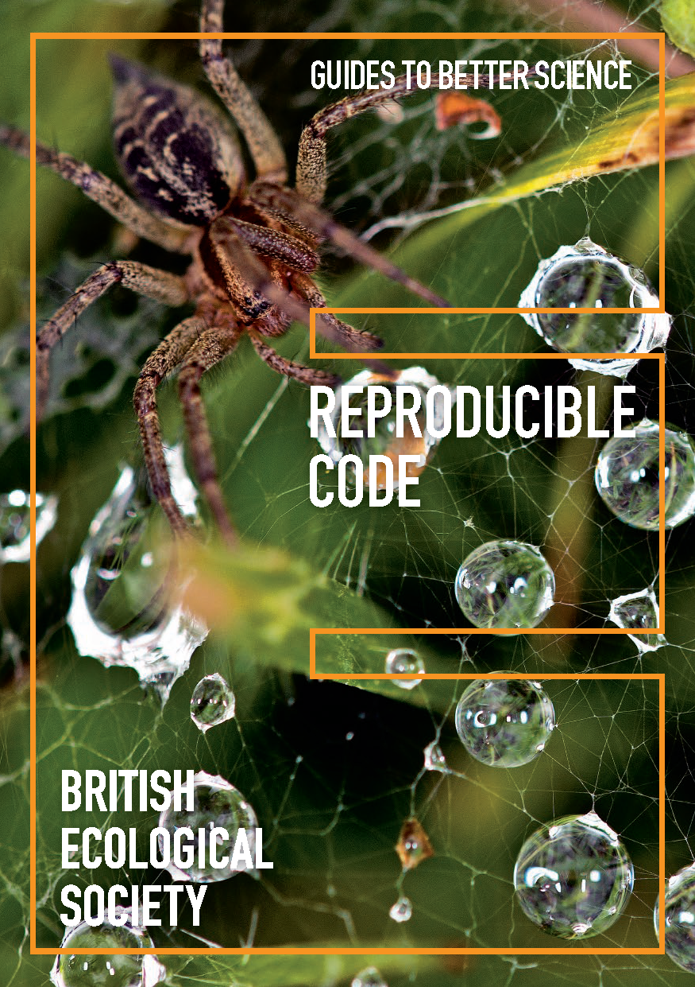

Slide 8
The added value of provenance
Increases understanding
Improves interpretation
Enables reproducibility
Confers trust

Slide 9
provenance, noun
Origin: Perhaps of multiple origins. A borrowing from French, combined with English elements. Perhaps partly formed within English, by derivation. Etymons: French provenance
Etymology: < French provenance origin, cause (1294 in Old French) < provenant , present participle of provenir
2. The fact of coming from some particular source or quarter; origin, derivation. In quot. 1785 perhaps with sense ‘good breeding, gentility’.
1785 E. Sheridan Let. in Betsy Sheridan's Jrnl. (1986) ii. 61 Miss Anstruther as I before mention'd Elegant, fashionable in her appearance, but nothing of that provenance in her manner that caught me so much in Miss Brook.
3. The history of the ownership of a work of art or an antique, used as a guide to authenticity or quality; a documented record of this.A distinction is sometimes drawn between the ‘origin’ and the ‘provenance’ of an article, as in quot. 1960.
1867 Times 7 Sept. 12/4 Other studies for Titian's ‘Battle of Cadore’ are extant, and their ‘provenance’ from the late Dr. Wellesley's collection is strongly in favour of their authenticity.
1960 E. A. Lowe Eng. Uncial 21 A Canterbury origin is probable, Canterbury provenance is certain.
4. Forestry. The geographic source of tree seed; the place of origin of a tree. Also: seed from a specific location.
1933 Empire Forestry Jrnl. 12 198 The problem of seed origin embraces both the geographical location where the seed was collected...and the genetic character of the mother trees... In European literature the term ‘provenance’...has come to be used for the first phase of the problem.
OED online, accessed 9 Dec 2019
Notes:
†1. The proceeds from a business. Obsolete. rare.
1628 in Eng. Hist. Rev. (1918) Jan. 36 The whole provenance and profitt thereof shalbe devided into Twentie sixe partes.

Slide 10
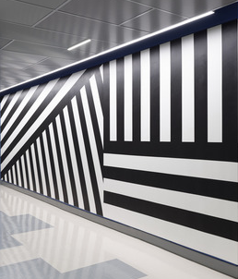
Artist: Sol LeWitt, American, 1928–2007
Wall Drawing # 630
January 1990
India ink
Gift of Alexis B. Dittmer and Jason J. Dittmer
2015.121.1
Culture:
American
Period:
20th century
Classification:
Wall Drawings
Geography:
Made in United States
Status:
By appointment
Provenance:
Thomas and Frances Dittmer, Jason and Alexis Dittmer, Given to Yale University Art Gallery on September 9, 2015
Bibliography:
“Acquisitions July 1, 2015–June 30, 2016,” https://artgallery.yale.edu/sites/default/files/files/Pub_Bull_acquisitions_2016.pdf (accessed December 1, 2016).

Slide 11
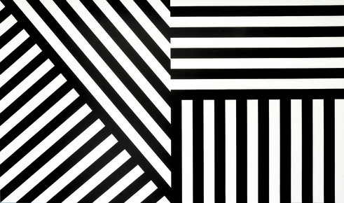
https://www.artsy.net/show/mass-moca-sol-lewitt-a-wall-drawing-retrospective
Notes:
Sol Lewitt. Wall Drawings 630 and 631
630: A wall is divided horizontally into two equal parts. Top: alternating horizontal black and white 8-inch (20 cm) bands. Bottom: alternating vertical black and white 8-inch (20 cm) bands.
631: A wall is divided into two equal parts by a line drawn from corner to corner. Left: alternating diagonal black and white 8-inch (20 cm) bands from the lower left. Right: alternating diagonal black and white 8-inch (20 cm) bands from the upper right.
January 1990
India ink
Yale University Art Gallery Gift of Alexis B. Dittmer and Jason J. Dittmer
First Installation Galerie Onrust, Amsterdam
First Drawn By Paul Kleijne, Milco Onrust, Marien Schouten
MASS MoCA Building 7 Second Floor
In his first wall drawings, Sol LeWitt reduced drawing to its most basic element: the line, which he drew in four directions (vertical, horizontal, diagonal left, and diagonal right.) These lines in four directions have become a signature formal element for the artist. They are often organized into a square divided into four equal parts, each part with a line in a different direction. However, in Wall Drawing 630 and Wall Drawing 631 (shown on the same wall at MASS MoCA) the lines, which have been translated into wide India ink bands, take up the entire wall. The four types of lines abut each other, creating natural divisions of the wall. By pairing the two drawings, which were originally exhibited together at Galerie Onrust, Amsterdam, LeWitt creates a graphic, dynamic presentation of the classic lines in four directions.
Sol LeWitt: A Wall Drawing Retrospective opened to the public on November 16, 2008, after nearly six months of intensive drafting and painting by a team comprising twenty-two senior and experienced assistants who worked with the artist over many years; thirty-three student interns from Yale University, Williams College, the Massachusetts College of Liberal Arts, and fourteen other colleges and universities; and thirteen local artists and recent graduates and postgraduates from many of the nation’s leading studio-art programs.

Slide 12
Sol Lewitt. Wall Drawings 630 and 631
630: A wall is divided horizontally into two equal parts. Top: alternating horizontal black and white 8-inch (20 cm) bands. Bottom: alternating vertical black and white 8-inch (20 cm) bands.
631: A wall is divided into two equal parts by a line drawn from corner to corner. Left: alternating diagonal black and white 8-inch (20 cm) bands from the lower left. Right: alternating diagonal black and white 8-inch (20 cm) bands from the upper right.

Slide 13
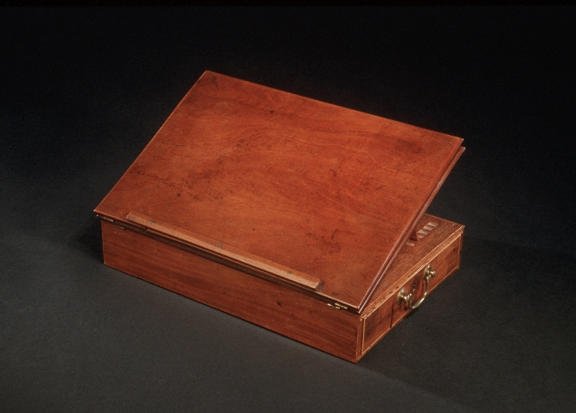

Slide 14
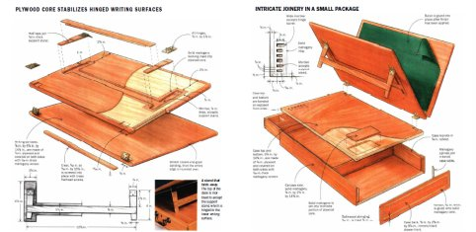
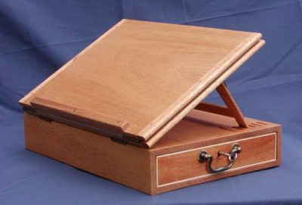
© Lon Schleining

Slide 15
Provenance is a formal representation of the context and execution of a computation
Pasquier et al. (2018). IEEE Computing in Science & Engineering 2018: 111-124.
Notes:
Data provenance is a formal representation of the context and execution of a computation. This
information is represented as a directed acyclic graph (DAG), a structure amenable to computational
analysis. We use the World Wide Web Consortium (W3C) standard for data provenance:
PROV-DM. Figure 1 shows a simple provenance graph. Vertices represent entities (representing
data), activities (representing actions or transformations), and agents (representing users or organizations).
In this figure, a process, controlled by Scientist Sarah, uses an executable function
(a program) and an input file (data) to generate an output. (Pasquier et al. 2018 IEEE Computing in Science & Engineering)

Slide 16
Collect Provenance
Use Provenance
Store Provenance
Notes:
We have spent many years developing tools like rdt and rdtLite, but despite the existence of tools to collect provenance, domain researchers don’t collect provenance for provenance’s sake
But they might use useful tools that use provenance.

Slide 17
Creating provenance is a challenging software-engineering problem
How much information is needed?
How do you keep track of it?
How do you use it
Updating and versioning
Permanence
Horror stories
Neither data repositories, Git, nor containers solves all problems
Reading data provenance can be tedious but tools that use it can improve reproducibility and trustworthiness of data and code

Slide 18
Collect Provenance
Use Provenance
Store Provenance
Notes:
So after many years of working on methods and associated tools to collect provenance (and our working tool, rdtLite, is now on CRAN), we have recently turned our attention to developing tools that use the provenance so that it can be collected and stored behind the scenes.

Slide 19
The rdtLite suite: Design principles
Trust
Documentation: provSummarizeR (CRAN), provExplainR (GitHub)
Traceability
Debugging: provDebugR (GitHub)
Visualization: provViz (CRAN)
Code cleanup and streamlining: provClean (development/GitHub)
Reproducibility
Encapsulation: encapsulator (in revision)
Notes:
provSummarizeR: Reads the provenance created by execution of a script or from commands in the console and provides a human-readable summary identifying the computing environment, libraries used, sourced scripts (if any), and inputs and outputs. It can also optionally save all the files on the provenance directory into a zip file. provSummarizeR uses provenance collected by the rdt or rdtLite packages. (takes in from provParseR).
Rclean: cleans up code for particular outputs
provDebugR: uses provenance to help debug scripts. Calls provParseR, provGraphR
provViz: allows the user to visualize a provenance graph collected by rdt or rdtLite using DDG Explorer (latter is java)
encapsulator: extended VM; written in Ruby, install with gem (linux); see Pasquier et al. 2018 for description

Slide 20
